Slide 8
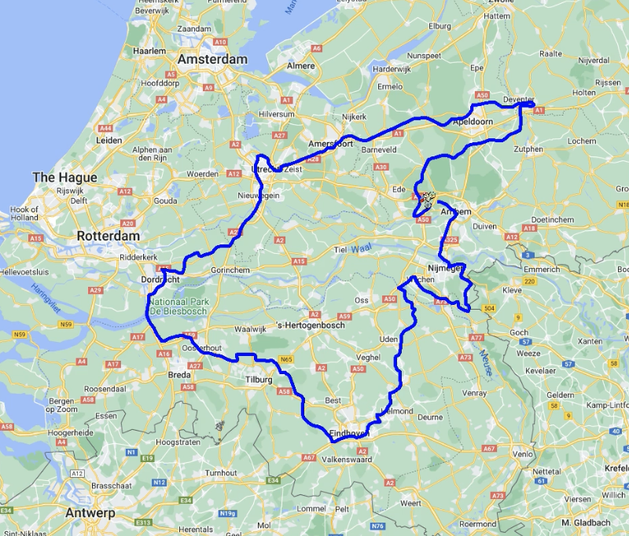

Slide 9
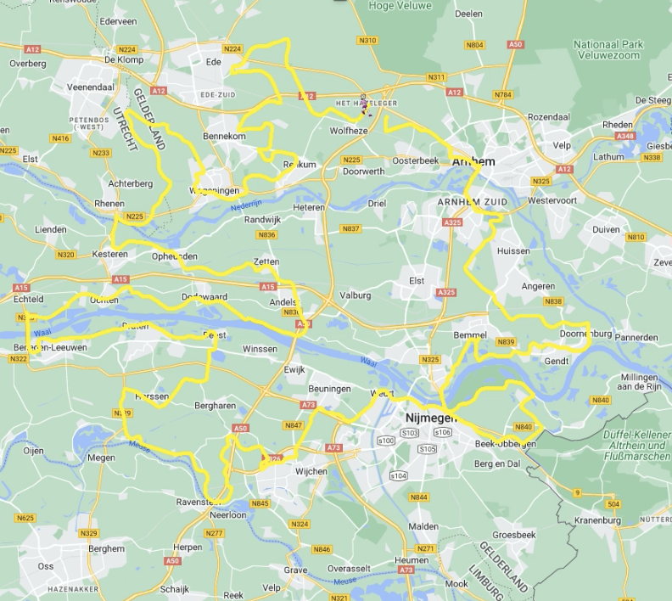

Slide 10
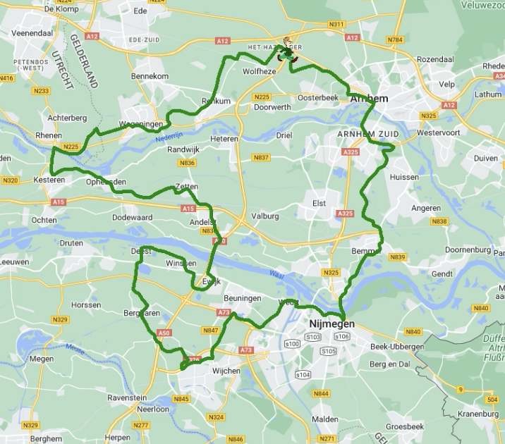

Slide 11
HomeRide MyMaps
HomeRun MyMaps
HomeWalk MyMaps

Slide 30
https://app.springcast.fm/podcast/door-weer-en-wind

