Slide 15
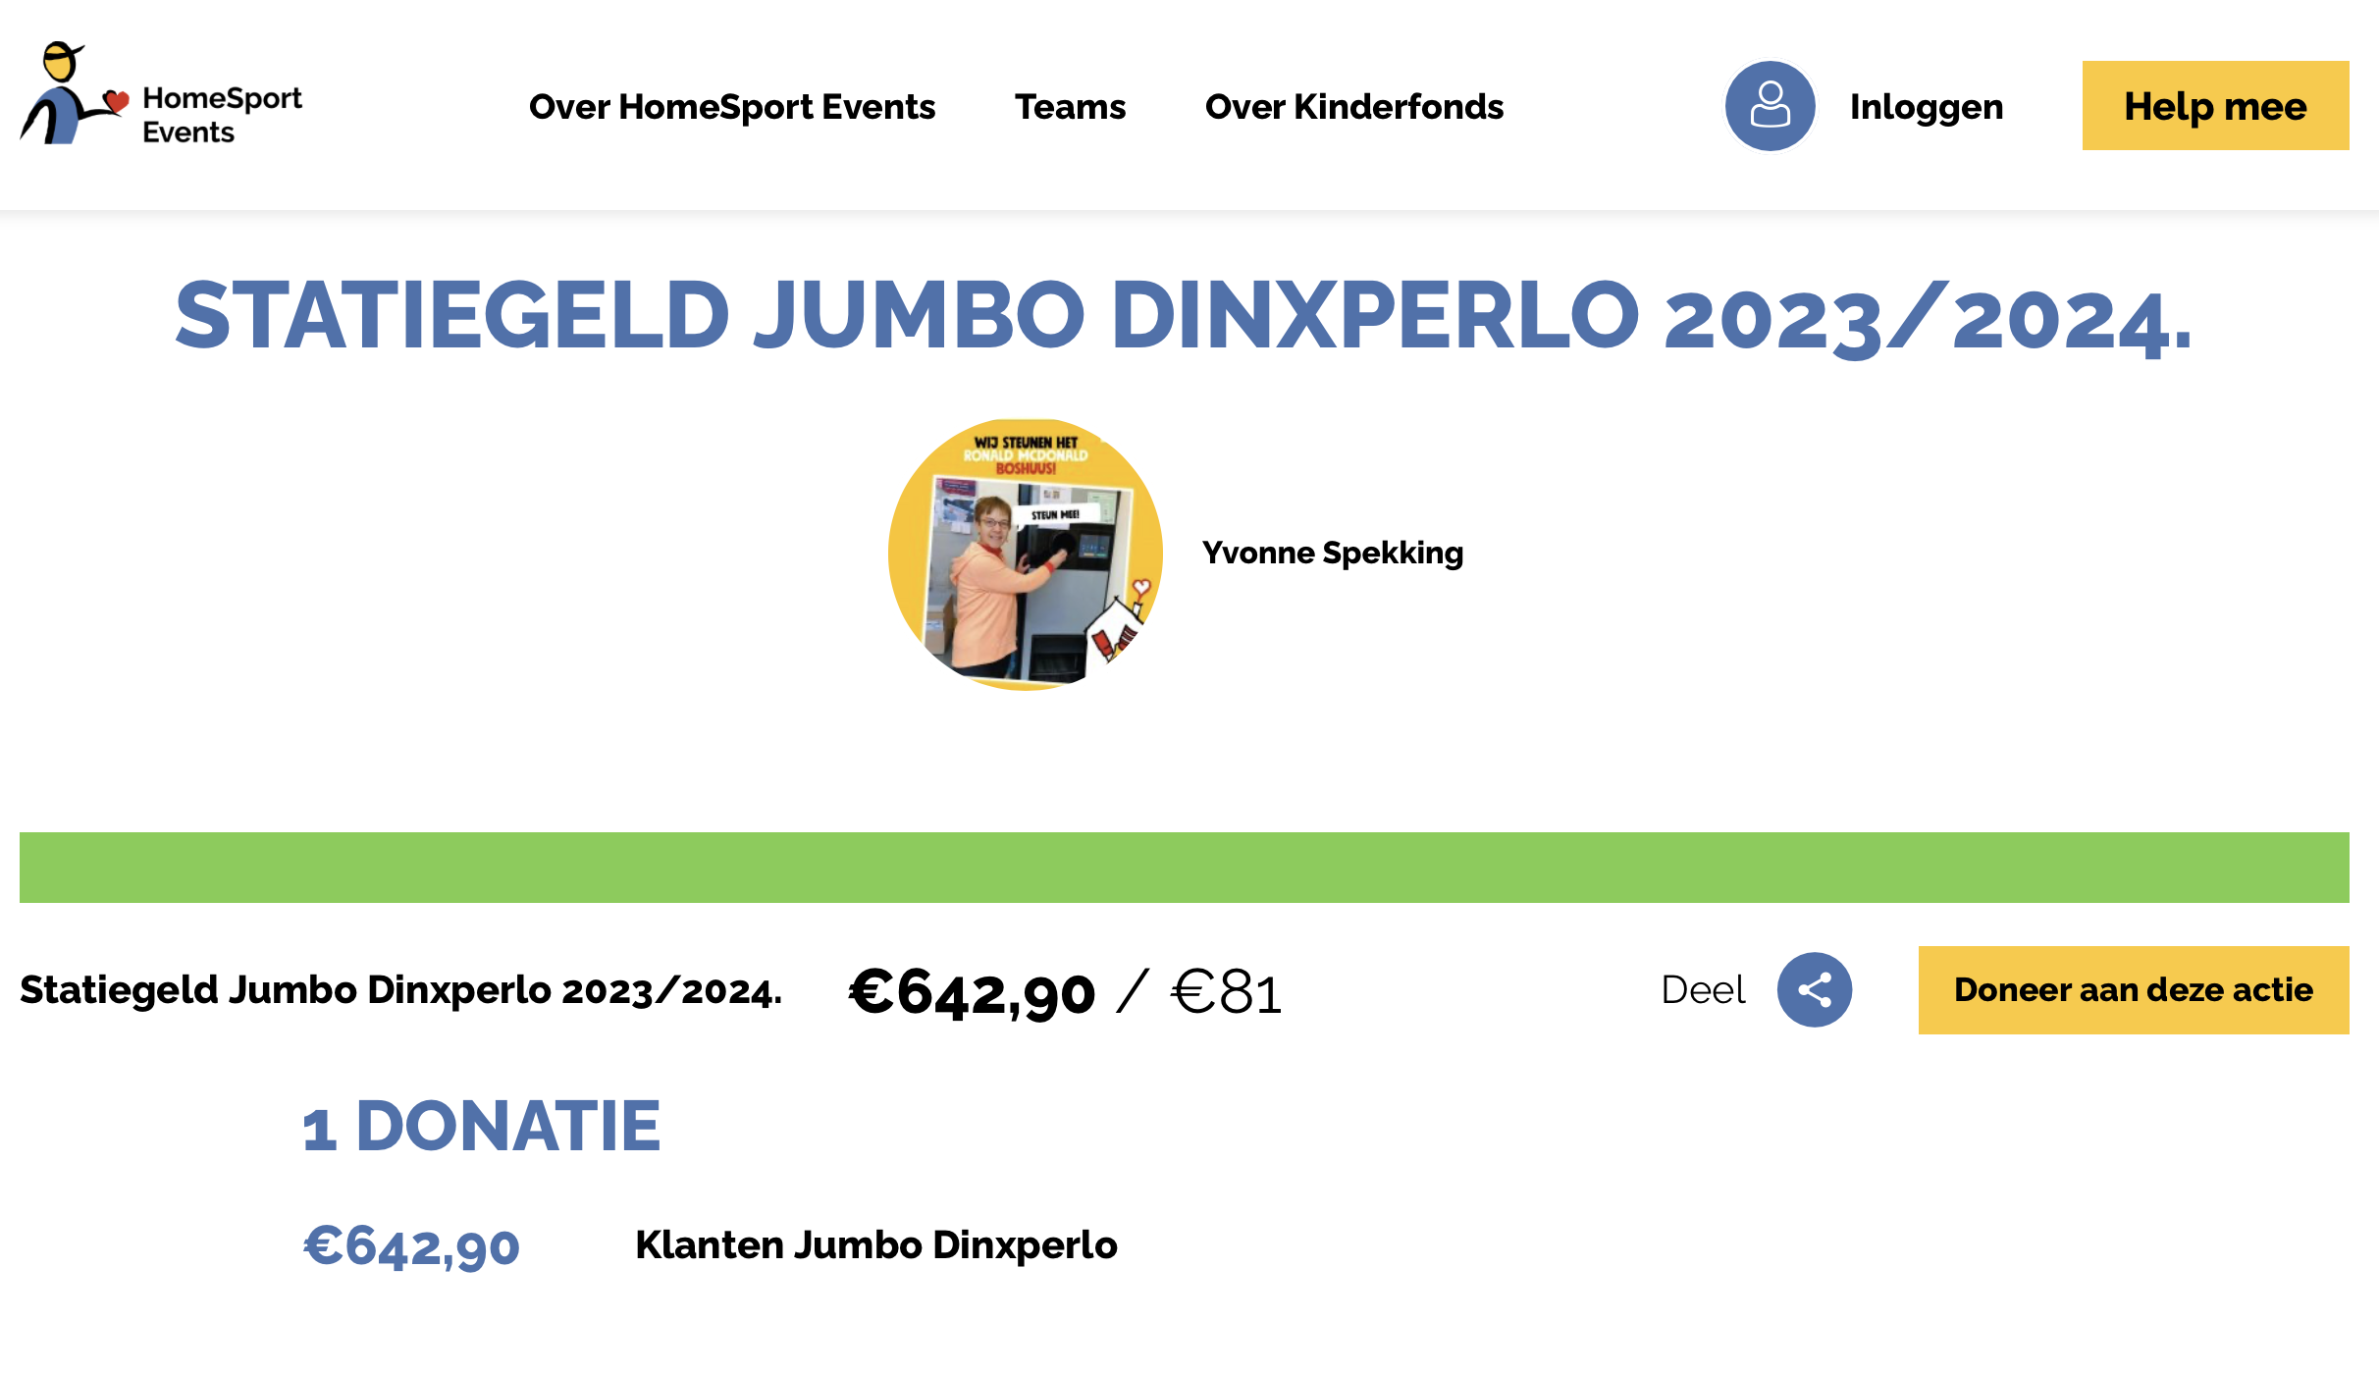
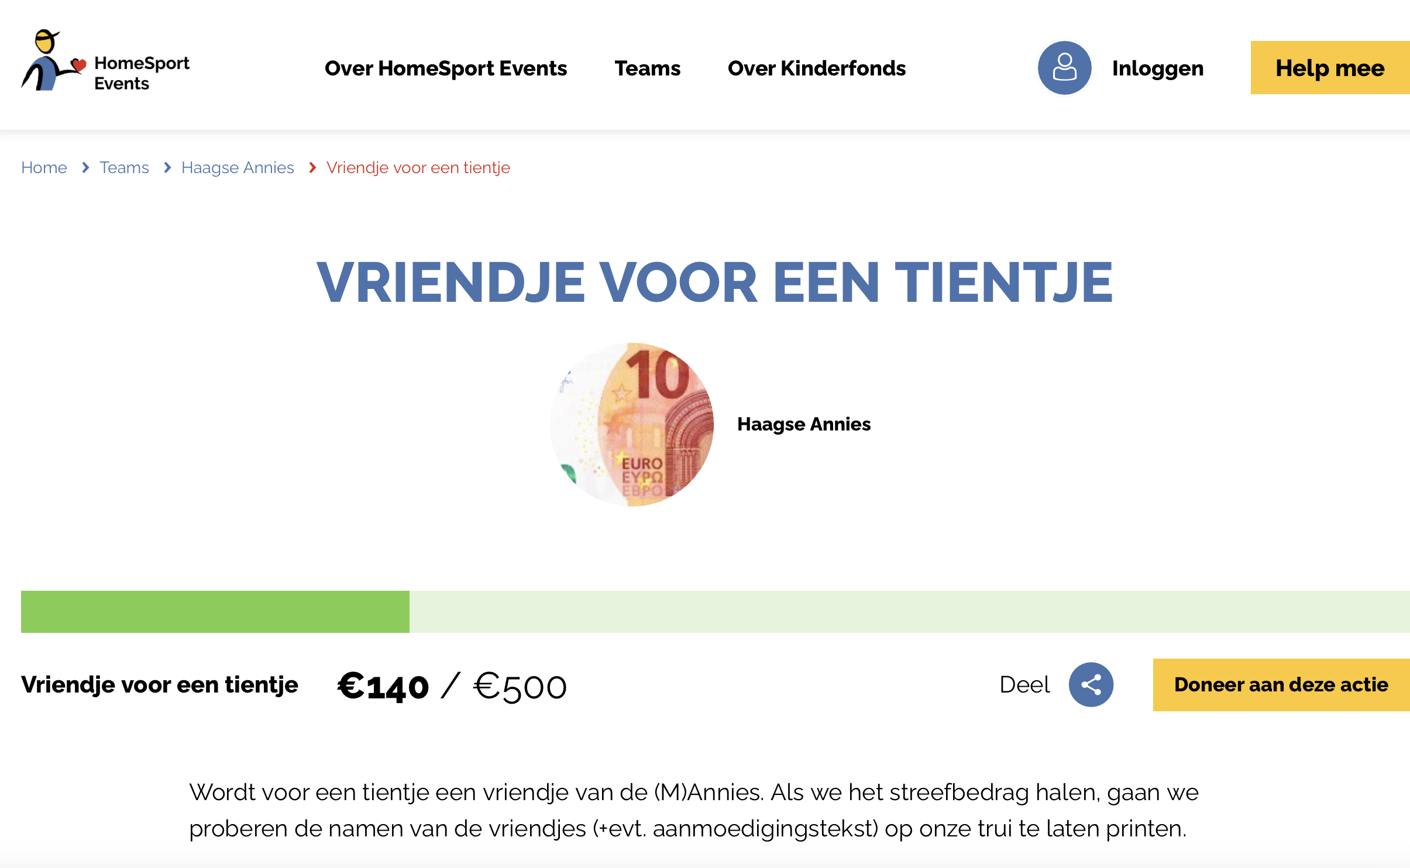

Slide 21
https://forms.office.com/e/dZ36S1UTrG

